Slide 1
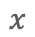

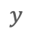
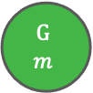
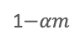
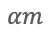


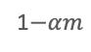

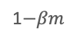
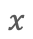

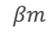
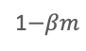

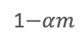

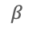
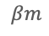

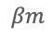
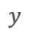
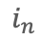
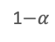


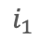

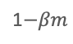
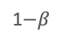
Fig 1
Environmental model
A
Two-state model
B
Multi-state model
G
G
$$1$$
$$αm$$
G
$$2$$
$$αm$$
$$αm$$
G
$$m$$
1$−α$
1$−αm$
. . .
1$−αm$
1$−αm$
$$β$$
$$α$$
$$βm$$
$$αm$$
B
B
$$m$$
$$βm$$
B
$$βm$$
$$βm$$
B
$$1$$
1$−β$
1$−βm$
$$m−1$$
. . .
1$−βm$
1$−βm$
Dormancy model
C
Two-state model
D
Multi-state model
I₁
. . .
I_{n}
$$i_{1}$$
$$x$$
$$x$$
$$d$$
$$d$$
$$i_{n}$$
A
$$d$$
D
A
$$d$$
D
$$r$$
∅
$$r$$
∅
$$y$$
$$y$$
Good environment
Bad environment

Slide 2
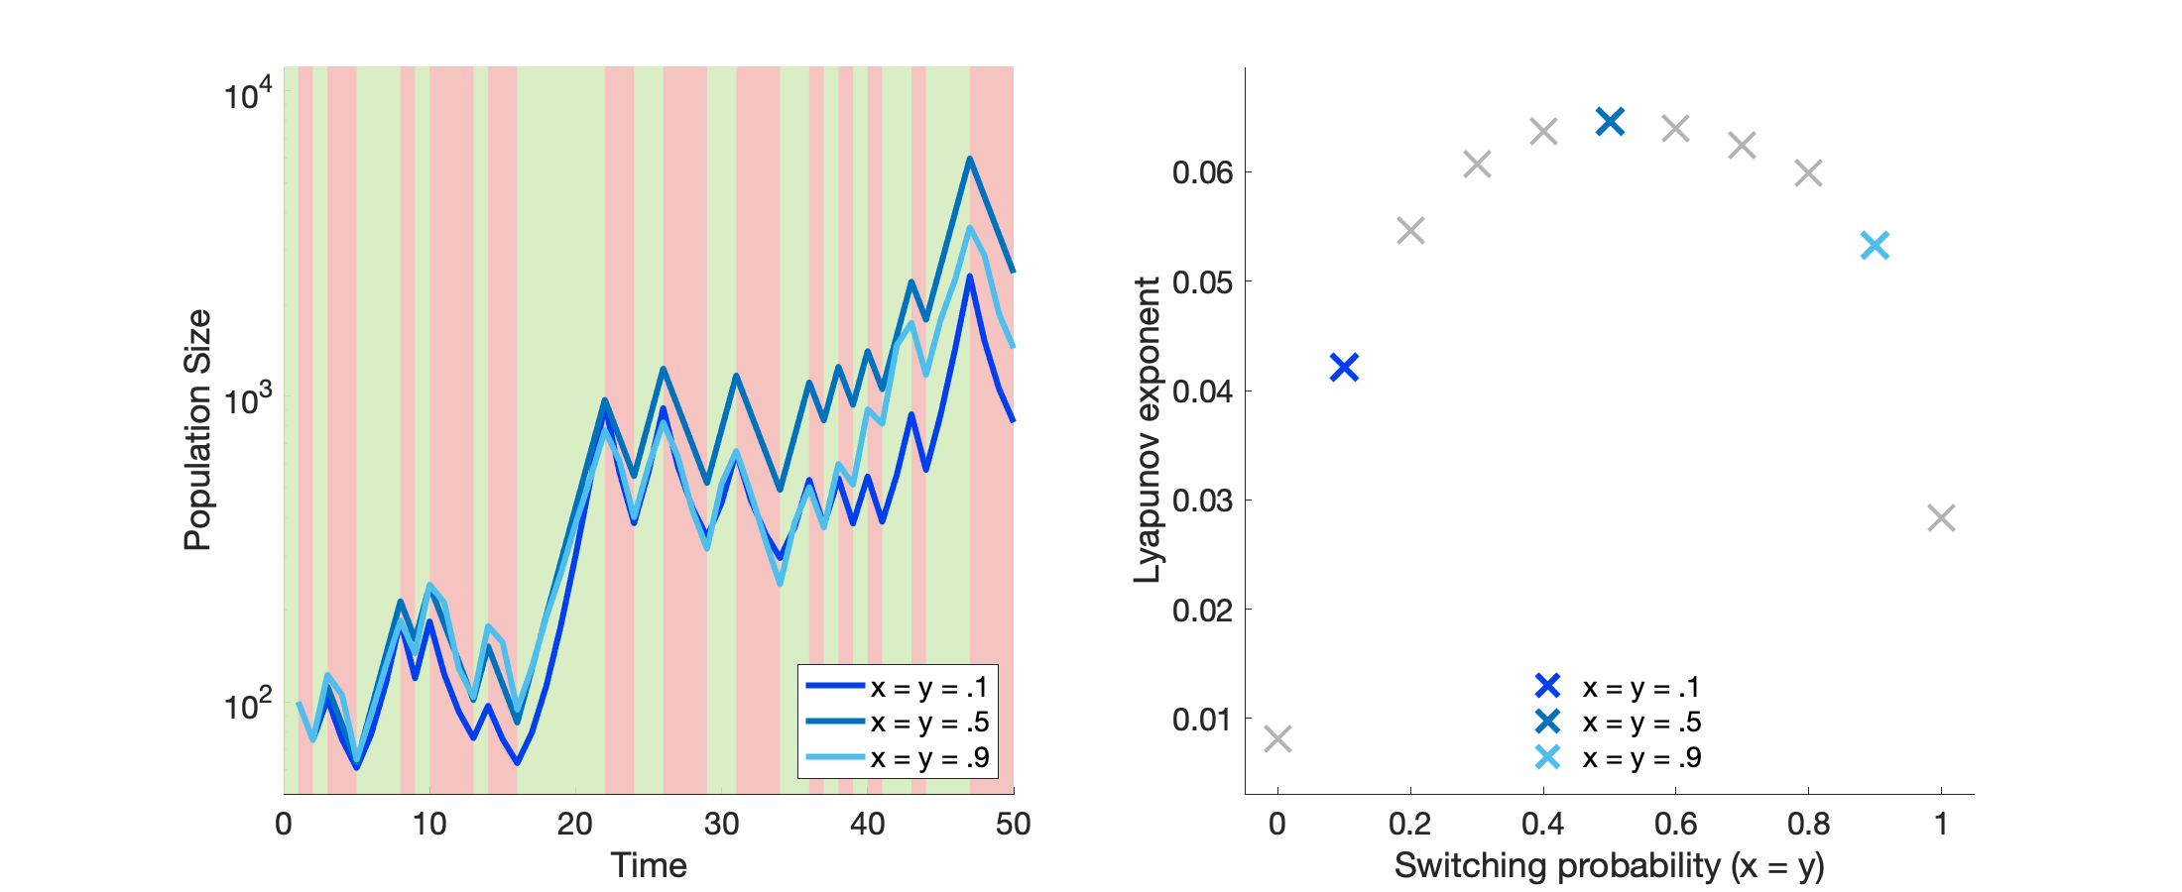
Fig 2
A
Good environment
Bad environment
B
G
G
G
G
G
G
G
G
G
G
G
G
G
B
B
B
B
B
B
B
B
B
B
B
B
B

Slide 3
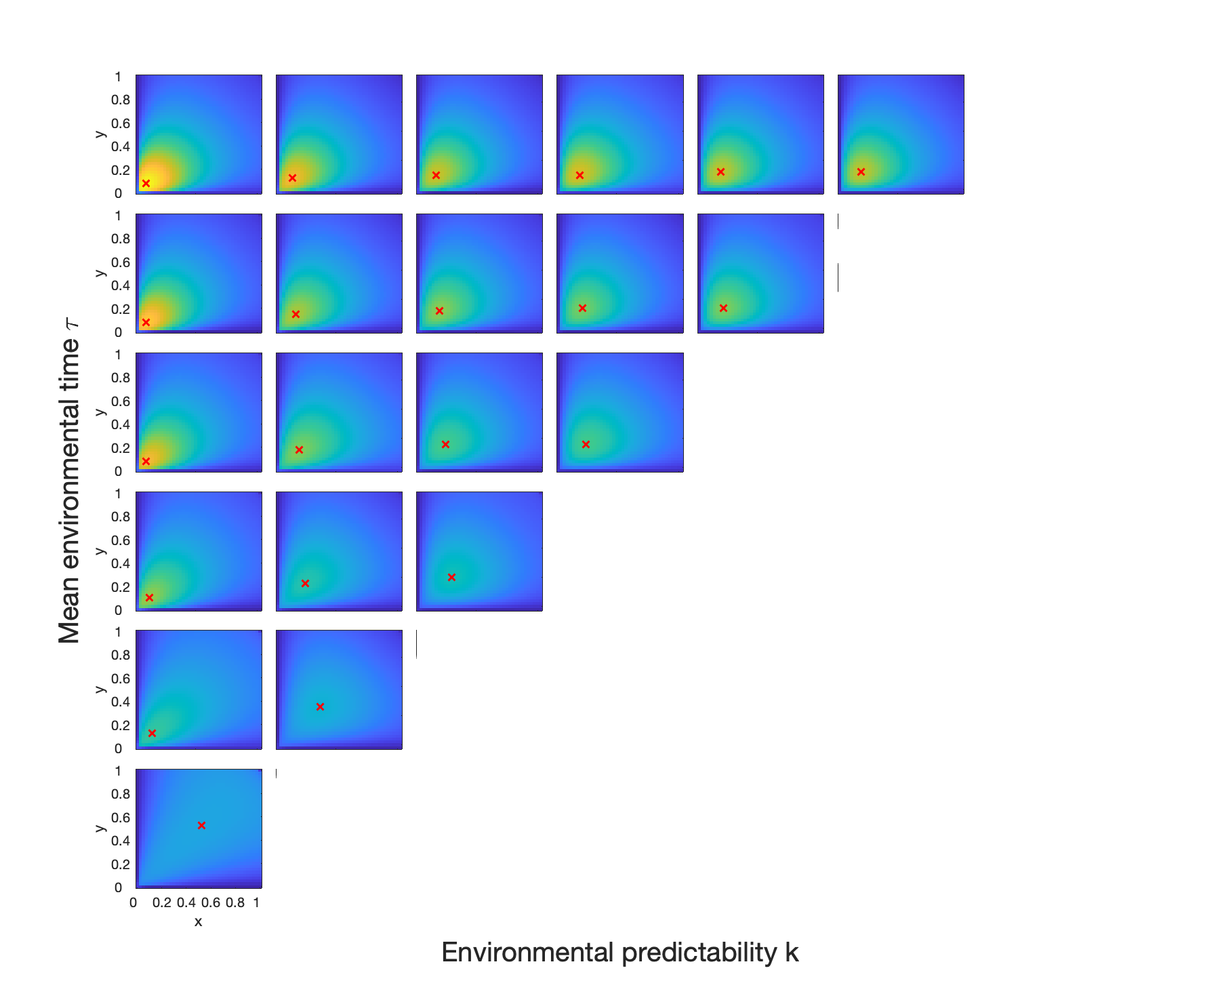

1
2
3
4
5
6
Fig 3
7
6
5
4
3
2

Slide 4
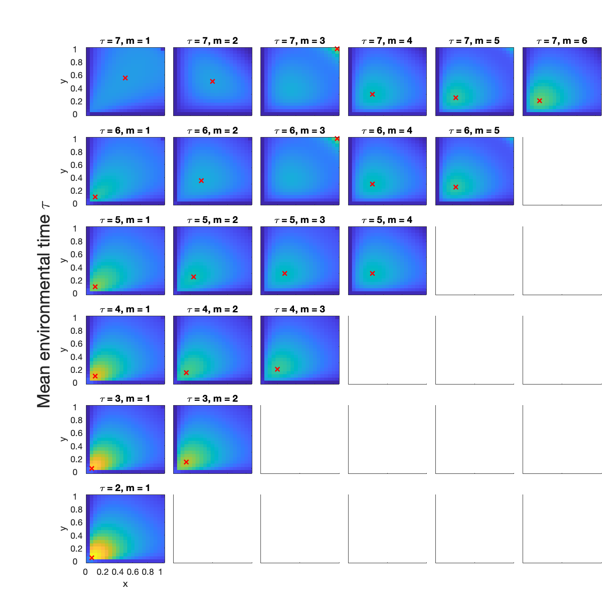
1
2
3
4
5
6
Fig 3
7
6
5
4
3
2

Slide 5
1
2
3
4
5
6
Fig 3
7
6
5
4
3
2

Slide 6
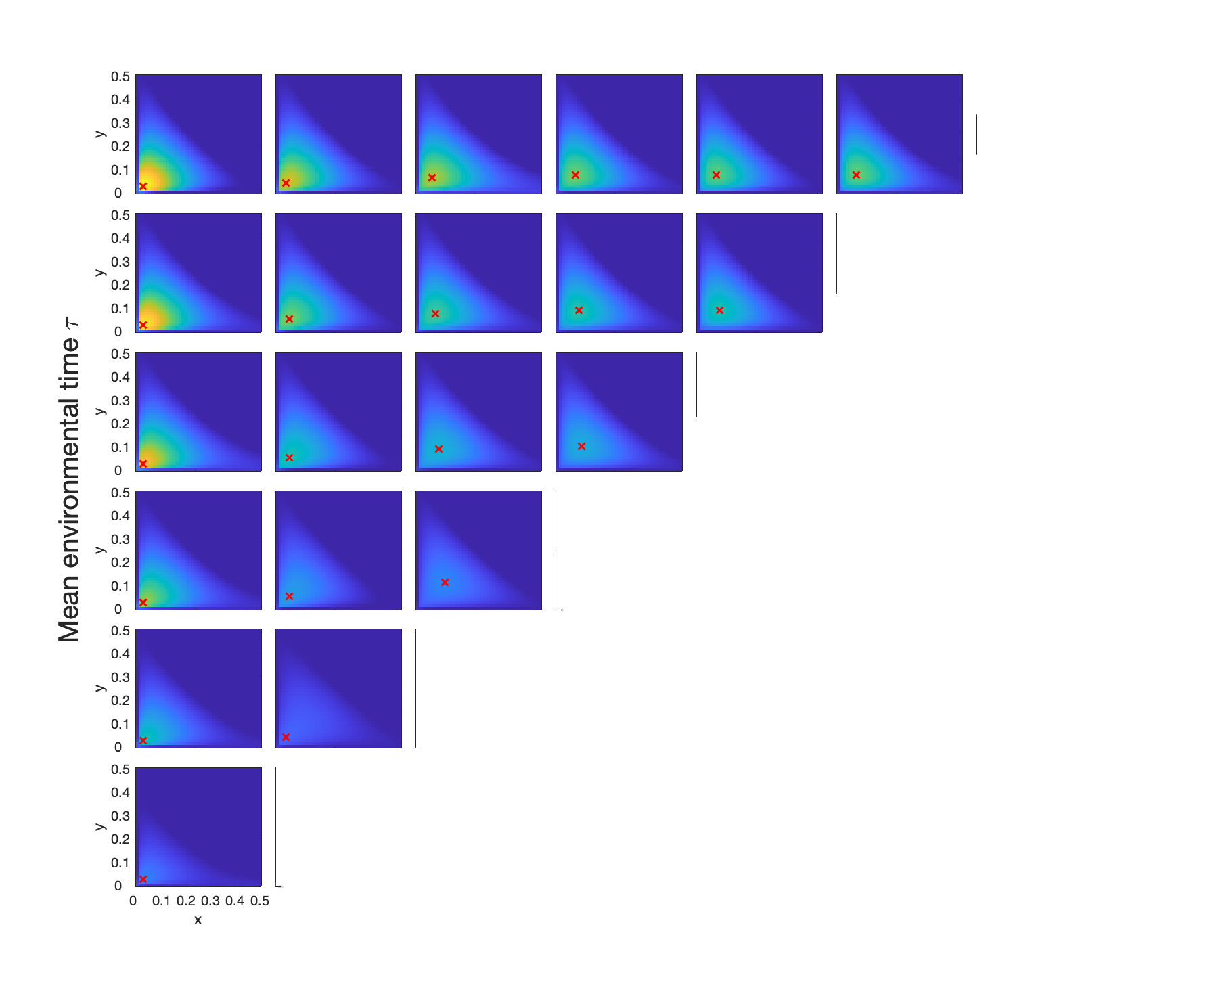
1
2
3
4
5
6
Fig 4
7
6
5
4
3
2

Slide 7
Fig 5
A
B

Slide 8
Fig 6
A
B

Slide 9
Fig 7
Environmental predictability (m)
A
B
C
D

